Slide 1



zomato_Sales_Analysis_Powerbi
View in Power BI
Last data refresh:
6/14/2024 4:45:18 PM UTC
Downloaded at:
6/14/2024 4:50:48 PM UTC

Slide 2

Index
Notes:
image
No alt text provided
actionButton
No alt text provided

Slide 3
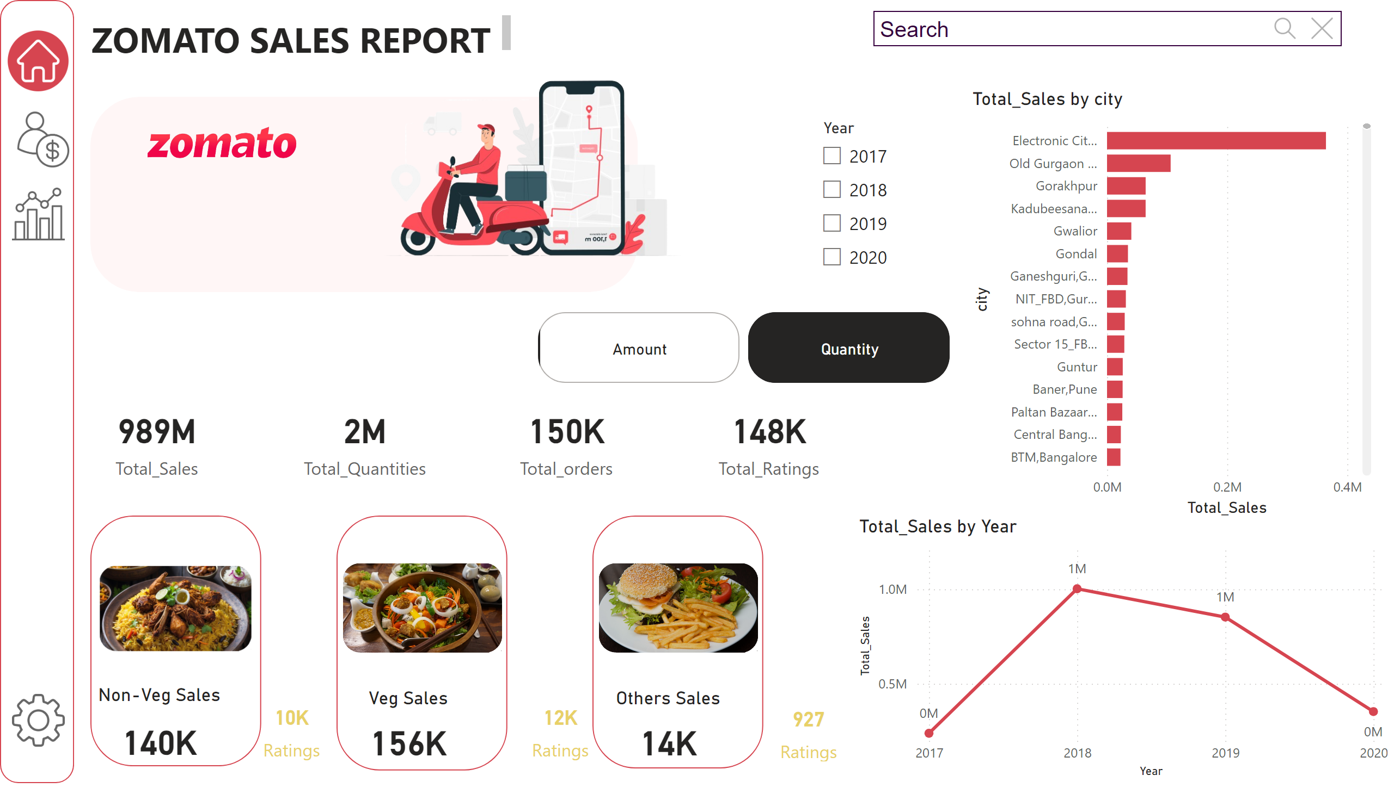
Overview
Notes:
card
No alt text provided
card
No alt text provided
card
No alt text provided
Non-Veg Sales
No alt text provided
Veg Sales
No alt text provided
Others Sales
No alt text provided
card
No alt text provided
clusteredBarChart
No alt text provided
lineChart
No alt text provided
card
No alt text provided
card
No alt text provided
card
No alt text provided
advancedSlicerVisual
No alt text provided
slicer
No alt text provided
shape
No alt text provided
shape
No alt text provided
shape
No alt text provided
image
No alt text provided
image
No alt text provided
image
No alt text provided
shape
No alt text provided
image
No alt text provided
image
No alt text provided
image
No alt text provided
image
No alt text provided
textbox
No alt text provided
shape
No alt text provided
image
No alt text provided
image
No alt text provided
textSearchSlicerF85E2E78BE4A4D7D9F99ED75B5D71C85
No alt text provided

Slide 4
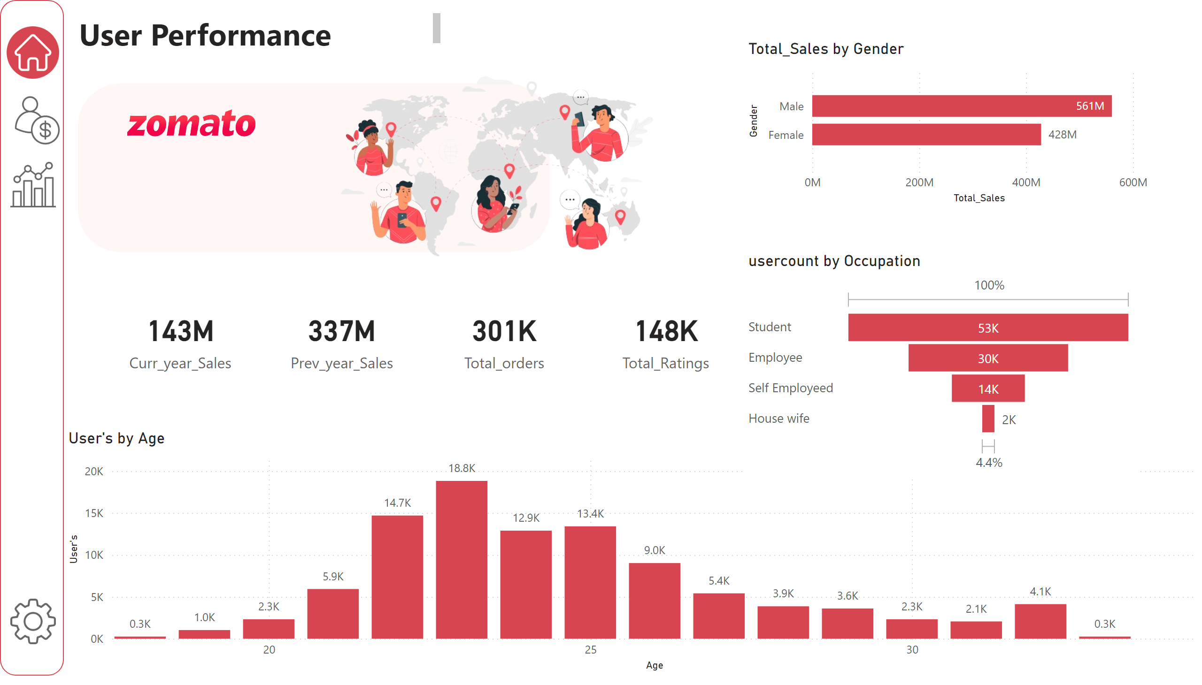
User Performance
Notes:
card
No alt text provided
shape
No alt text provided
image
No alt text provided
image
No alt text provided
image
No alt text provided
image
No alt text provided
textbox
No alt text provided
shape
No alt text provided
image
No alt text provided
clusteredColumnChart
No alt text provided
card
No alt text provided
image
No alt text provided
clusteredBarChart
No alt text provided
funnel
No alt text provided
card
No alt text provided
card
No alt text provided

Slide 5
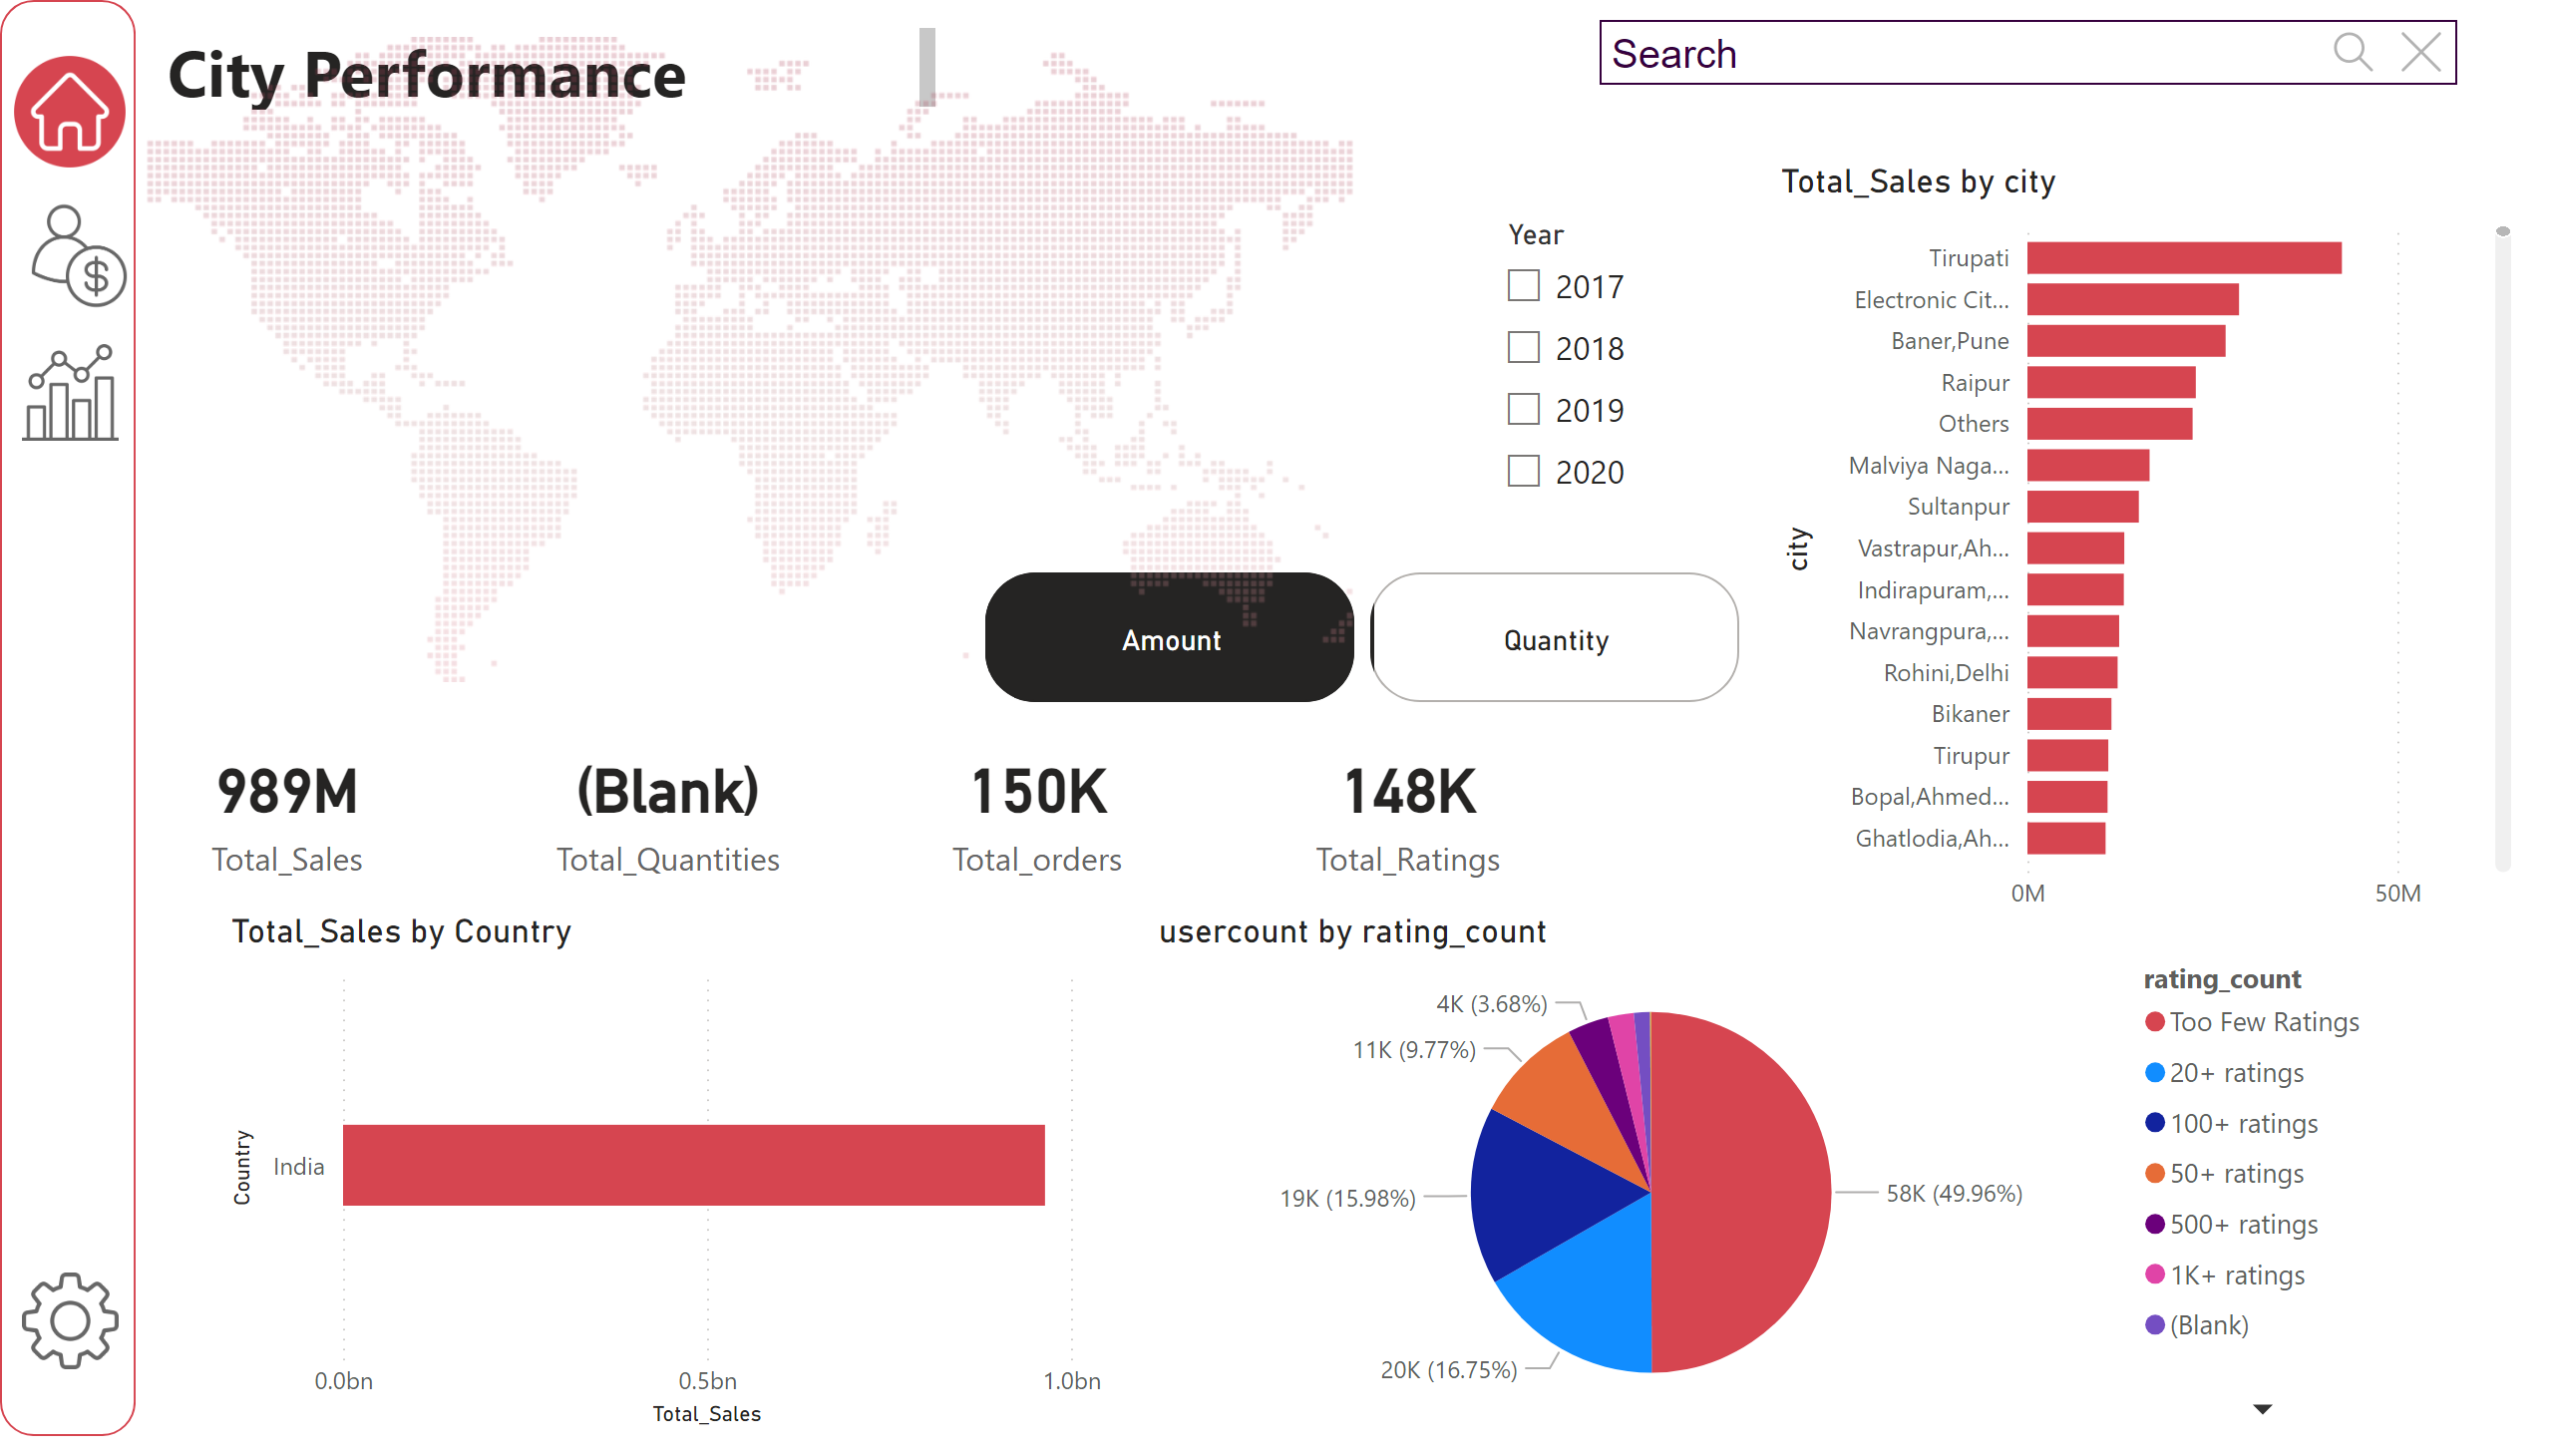
City Performance
Notes:
card
No alt text provided
card
No alt text provided
card
No alt text provided
card
No alt text provided
clusteredBarChart
No alt text provided
advancedSlicerVisual
No alt text provided
slicer
No alt text provided
shape
No alt text provided
image
No alt text provided
image
No alt text provided
image
No alt text provided
image
No alt text provided
textbox
No alt text provided
textSearchSlicerF85E2E78BE4A4D7D9F99ED75B5D71C85
No alt text provided
image
No alt text provided
clusteredBarChart
No alt text provided
pieChart
No alt text provided

